Slide 1
Predicting Vehicle CO2 Emission Rates
A Machine Learning Project

Slide 2
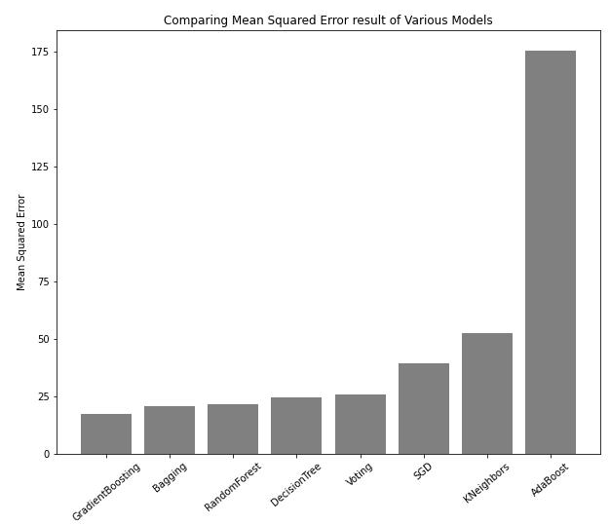
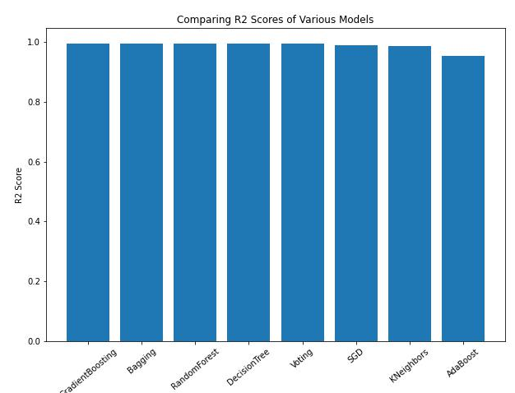
General Overview of Project Results
After evaluating all models, the GradientBoosting model (gdabpipe) emerged as the best model (0.995 and 17.36) in terms of both r-squared score and mean squared error respectively

Slide 3
Things learnt during project
Scaling does not play an important role in Machine Learning Regression problems
LabelEncoder works best with ordinal data therefore to prevent unnecessary ranking of items within a column, one needs to use Pandas’ get_dummies method
Pandas’ get_dummies method works just like One hot label encoding

